Slide 1
JK-12 International Education Symposium
WELCOME/BIENVENUE

Slide 2
Welcoming International and Newcomer Students

Slide 3
Today’s Panel
Thomas Christensen, Vital English
Douglas Wilson, HDSB International Students
Meg Carey, ESL/ELD Instructional Program Lead, Equity & Inclusive Education, HDSB

Slide 5
Before Students Arrive
HDSB and Vital English
-appropriate school placement
-information for school planning/timetabling
-orientation (place, education, culture, homestay
-ease of customization

Slide 6
When Students Arrive --
HDSB Welcome Centre

Slide 7
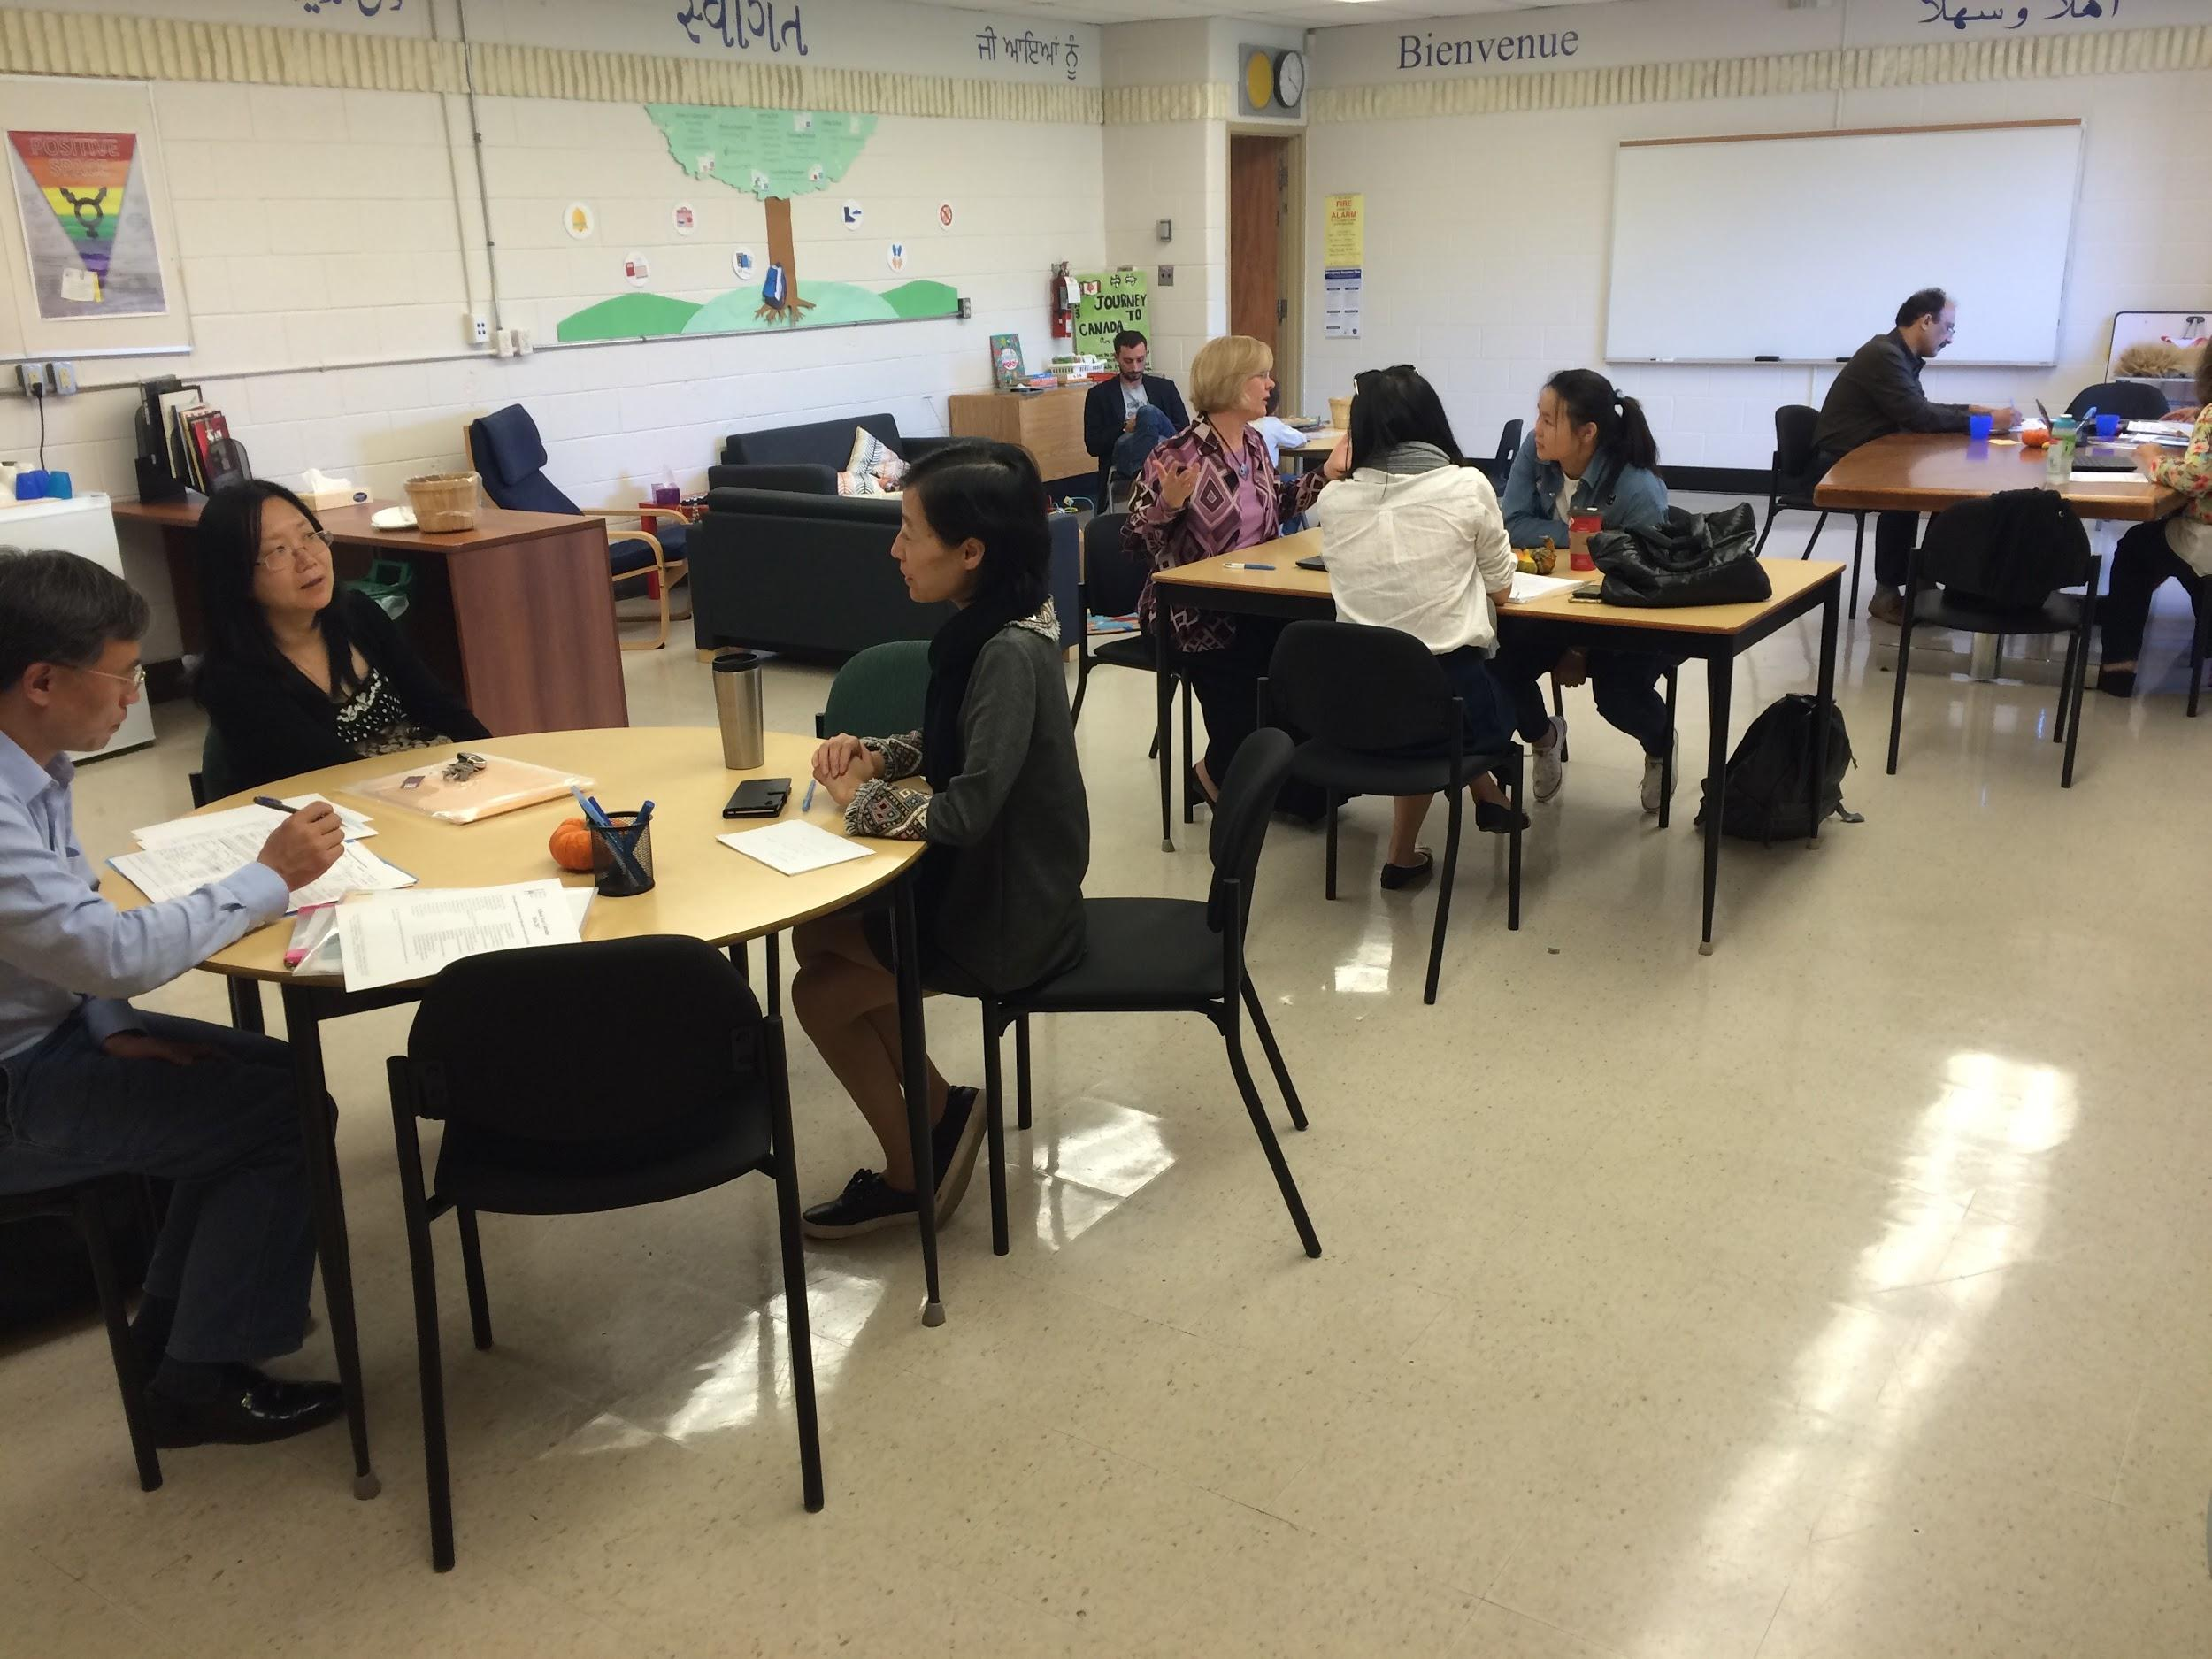
HDSB Welcome Centre @HDSBWelcome

Slide 8
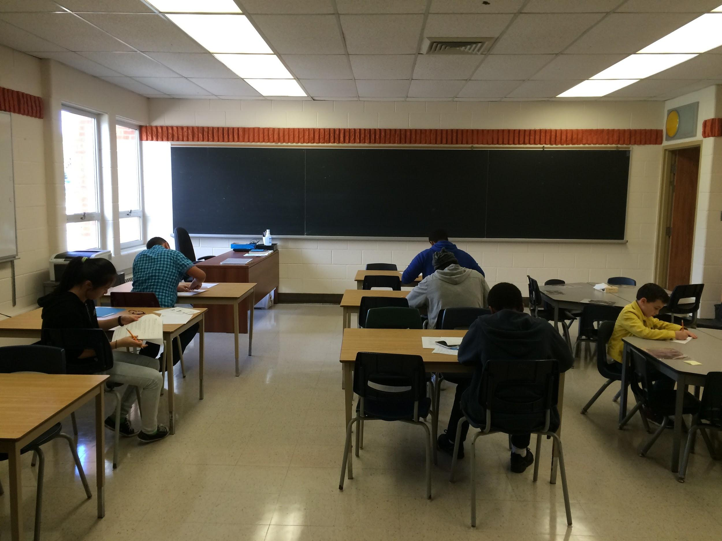
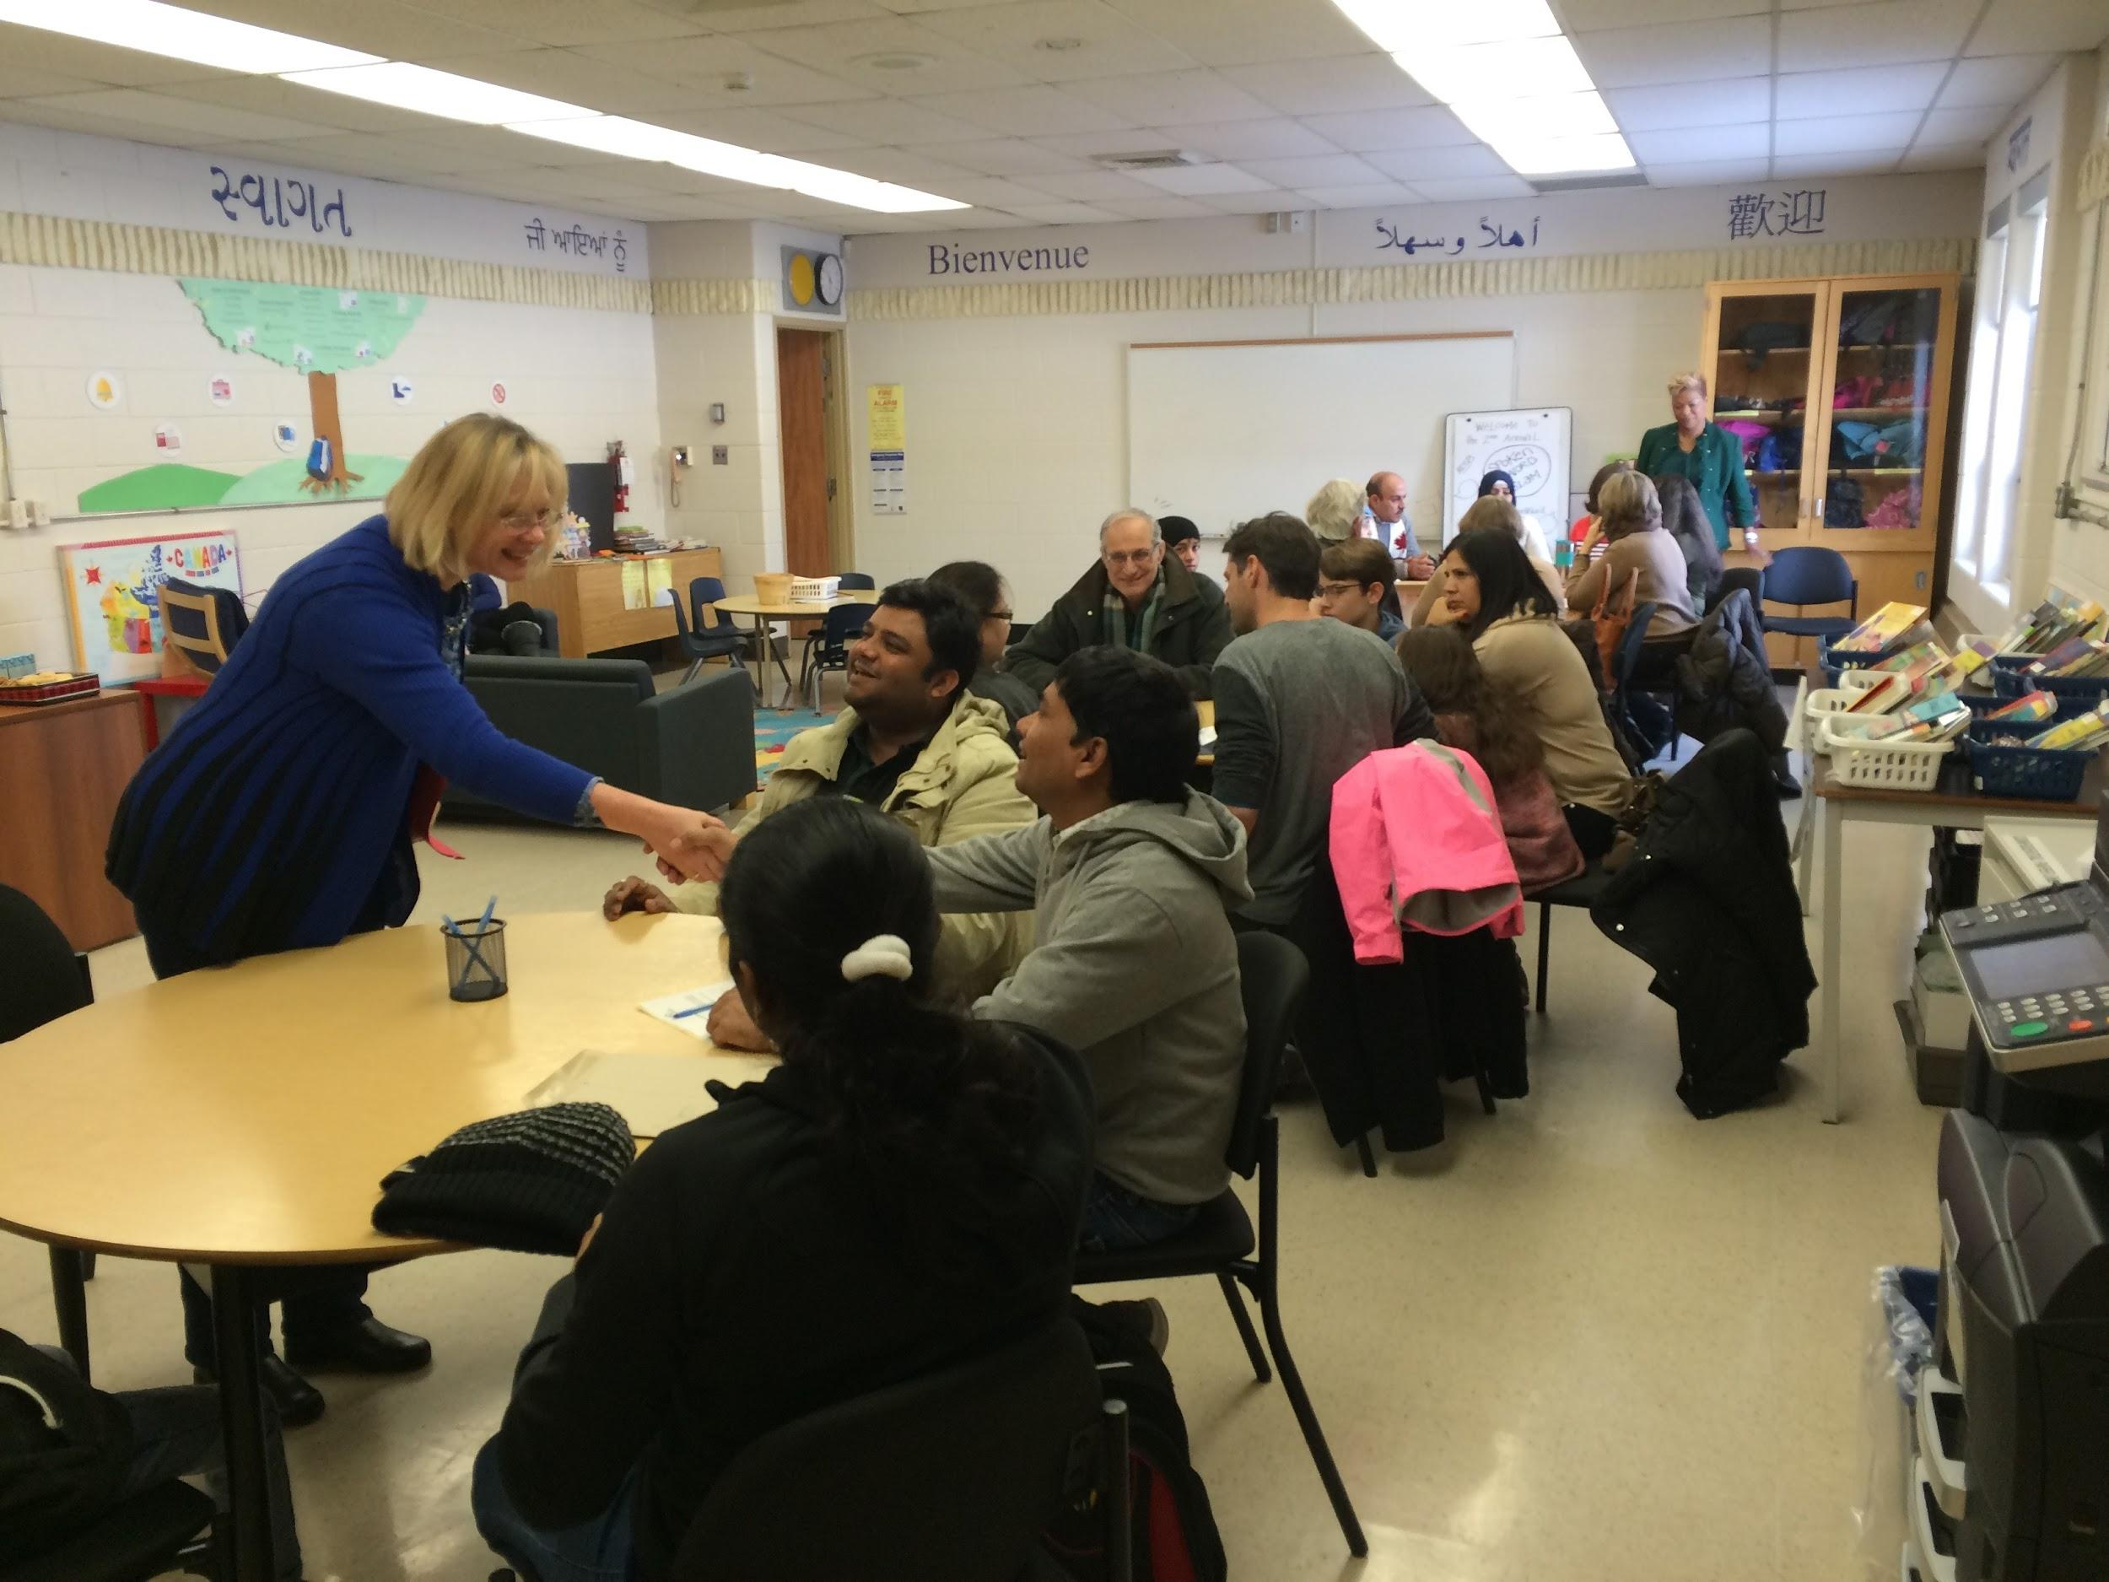
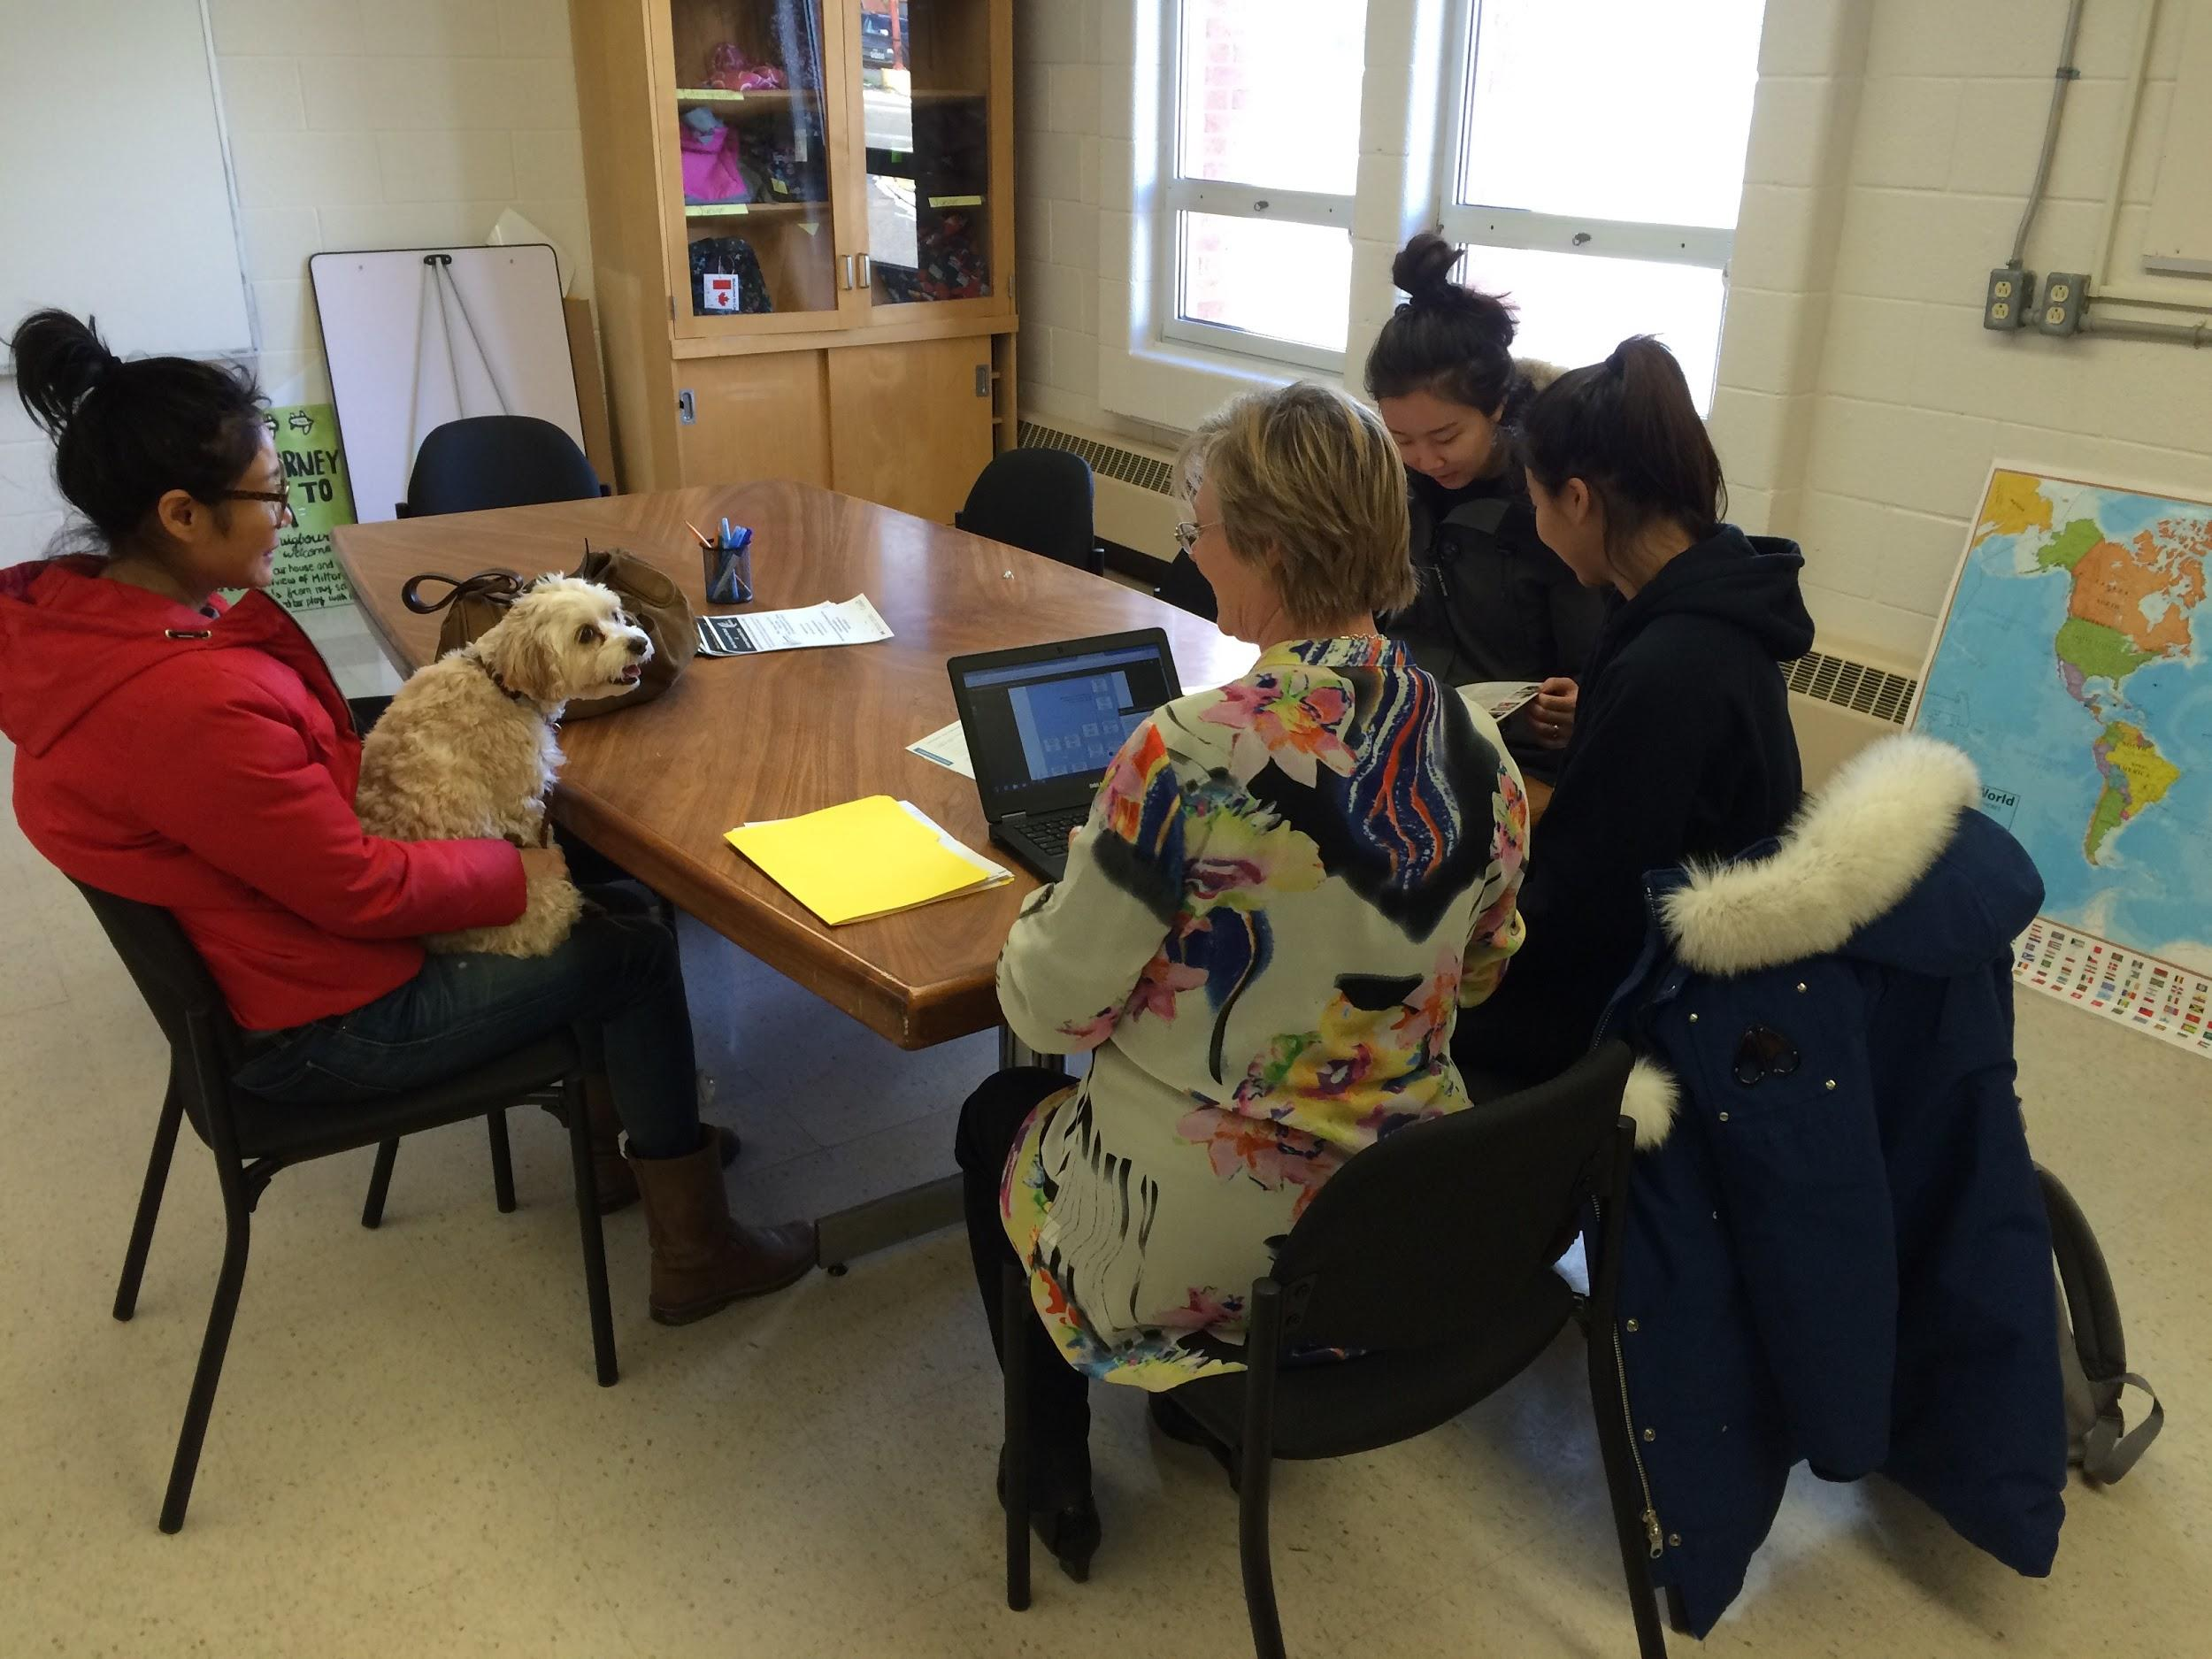
Assessment: Reading, Writing, Oral Language, Math

Slide 9
Initial Interview
Family Background
City/Country of origin?
Previous visits to Canada?
Parent/Guardian English?
Need for interpreters?
Health concerns?
Hearing? Vision?
Homestay?
How many people in house?
Who are they (e.g., family)?
Other languages at grade level? (spoken/written/reading)
Any other important information to share

Slide 10
Initial Interview
Previous Education/Experience with English
Current grade?
Date of last attendance?
Years of education?
Type of school?
(Private? Public? Rural?)
Interruptions?
Co-ed?
Grade of first English class?
Frequency of English class?
Additional English support?
Presentations? Group work?
Any special learning provisions needed? (e.g, IEP)

Slide 11
Initial Interview
Interests/ Strengths/Goals
Strongest subjects?
Difficult subjects?
School clubs?
Hobbies/Interests/sports?
Career pathway?
Education timelines?
Any other important information to share

Slide 12
Getting the Information to Schools
Halton Forms Engine
-summarize content and results from initial assessment
-shared electronically the next day
-populates Trillium with appropriate level
-available for all current teachers of the student on Student Profile

Slide 13
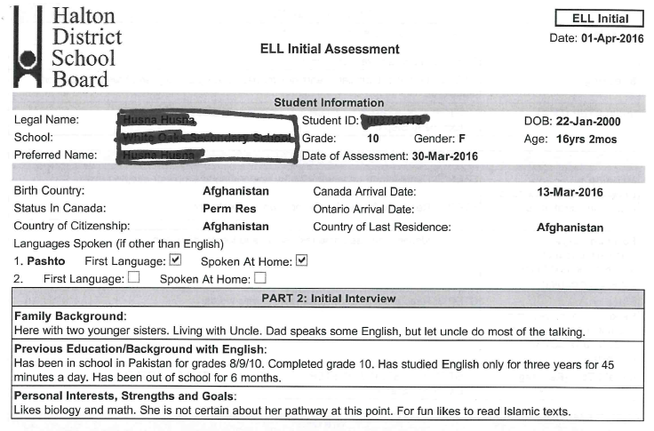

Slide 14
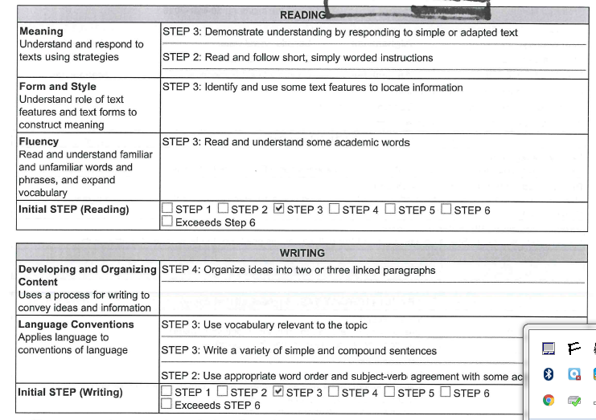

Slide 15
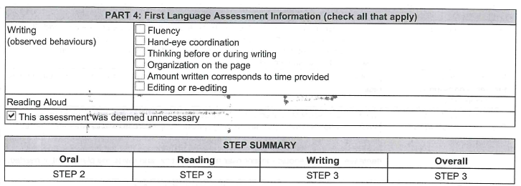

Slide 16
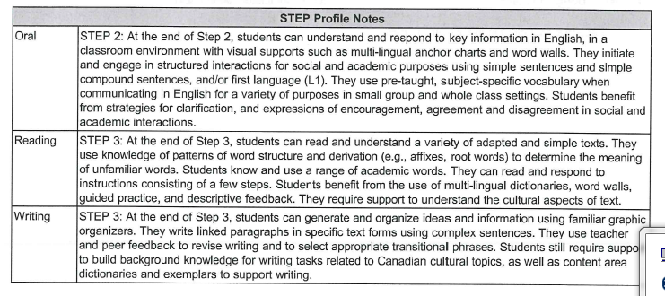

Slide 17
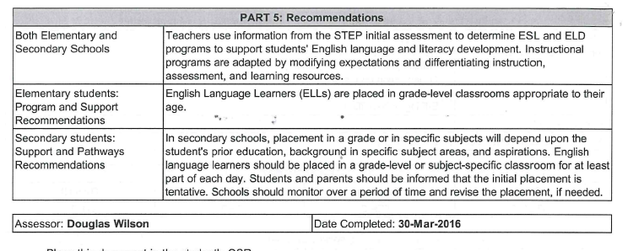

Slide 18
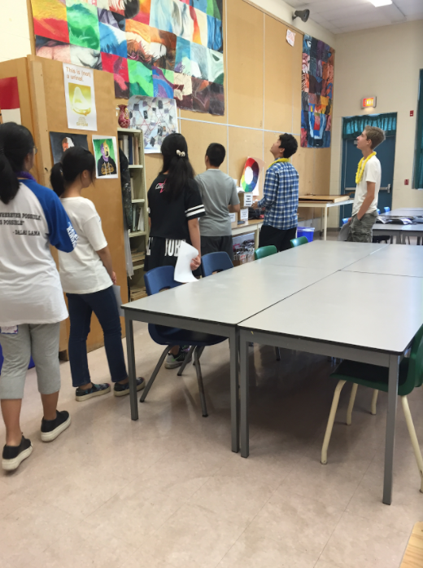
Welcoming & Receiving Students
@ School
Newcomer Ambassador Club
Mandate: The goals of the crew are to provide an inclusive and welcoming environment for new students as well as provide academic and social guidance throughout their first year at IRHS.
Link to summer mailing
Notes:
Meg

Slide 19
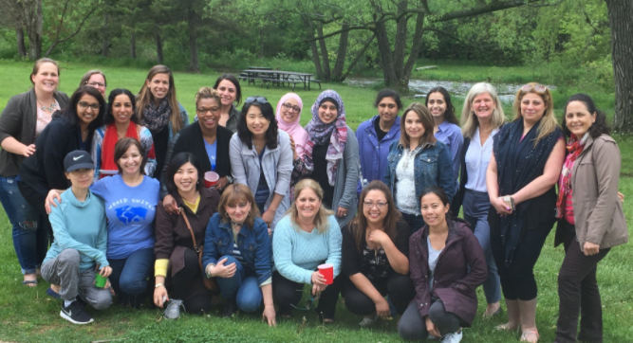
Welcoming & Receiving Students
@ School
Formal Partnership with the Halton Multicultural Council
Youth Settlement Specialists available to all schools
Notes:
Meg

Slide 20
Welcoming & Receiving Students
@ School
Facilitating Sharing Sessions Between Schools
Sessions to support:
School teams Administrators Guidance
Notes:
Meg

Slide 21
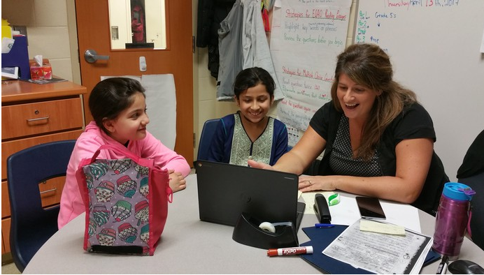
Welcoming & Receiving Students
@ School @ELLHdsb
Elementary Innovation Project
Connecting same-language student across the board!
Welcome Centre - School
School - School
Link to SMORE presentation
Notes:
Meg

Slide 22
Welcoming & Receiving Students
@ School
Other Initiatives:
class “welcome” project
students teaching teachers at lunch
parent council minutes in different languages
student mentors
summer orientation programs
in-school orientation
Designed by students @ Milton District High School
Notes:
Meg

Slide 23
Designed by students @ Milton District High School

